Slide 1
What causes Job/Career satisfaction in Computer Science and would you write unethical software?
William Pembleton

Slide 2
Abstract
What's the most interesting is what didn’t show up in the trees
Age
Open source
How long coding (professionally/non-professionally)
What time you wake up
Hours spent on the computer in a day
Exercise
How many meals do you skip in a week

Slide 3
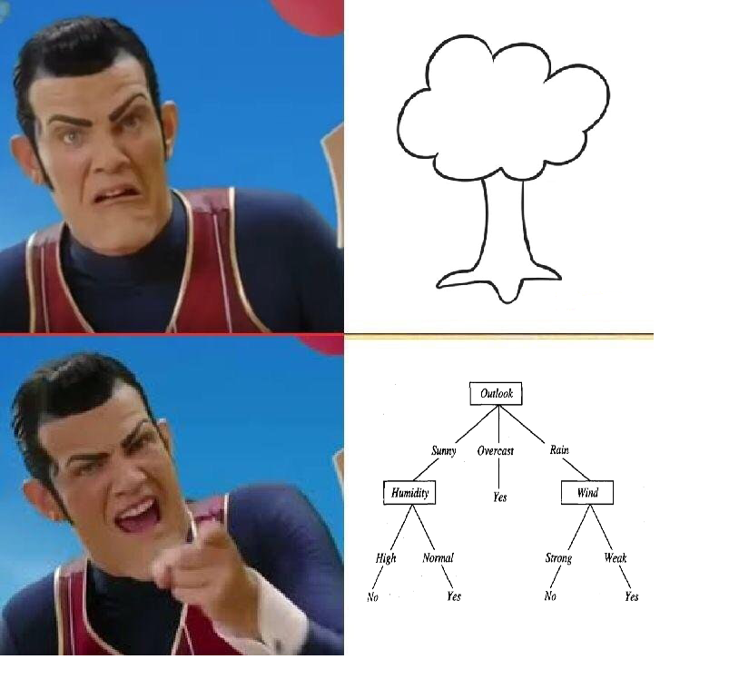
What’s J48?
J48 is a decision tree learning algorithm. It can take in a dataset and produce trees

Slide 4

Where’d I get my data from?
Stack Overflow is a Q&A website where developers can learn from each other
Every year they release a survey that asks developers question about their job

Slide 5
What do they ask about?
What kind of developer are you? (Full stack, back end, mobile)
How satisfied are you with your current job?
What languages do you use? (Java, Python, Pascal)
What IDE do you use? (Eclipse, IDLE, Sublime)

Slide 6
Methodological (Preprocessing)
They asked questions like “Which of the following developer types describe you? Please select all that apply.”
The way Stack Overflow stored this is something like “Full Stack; Database Administrator; DevOps”
Separated each of these out into their own column
DevType.Full Stack | DevType.Database Adminstrator | DevType.Devops
Yes | Yes | Yes
Yes | No | Yes

Slide 7
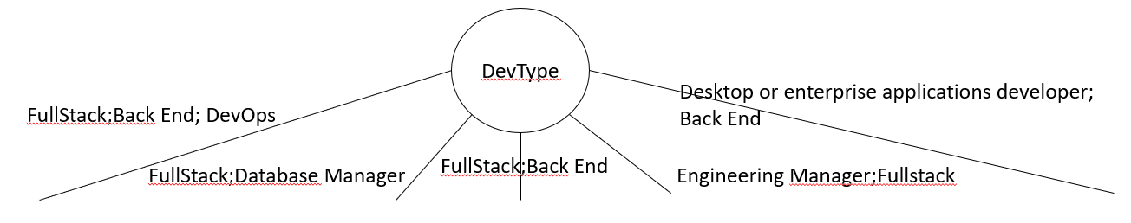
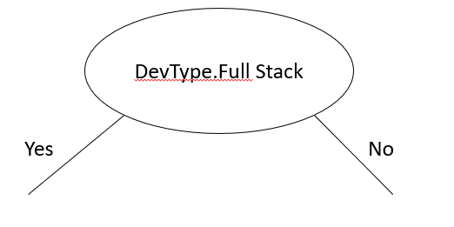
Methodological (Preprocessing)
This is so that the tree doesn’t turn into something like this with a ton of nodes
Now the tree will look like this

Slide 8



K-Fold Cross Validation
K-Fold cross validation is a way to grade how well a model did at it’s given task without spoiling any data
Split the data into k sections (Folds), save one fold for testing and use the others to train the model on
Repeat k times until you have k models and get an accuracy for each
Final model
50%
70%
30%
(50+70+30)/3 = 50%

Slide 9
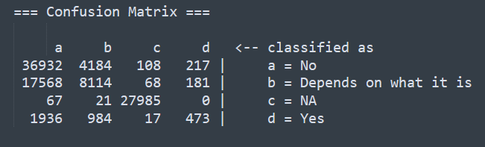
Confusion Matrix
A confusion matrix is an output that you can build with supervised learning algorithms
It is a way to tell what an algorithm thinks of a particular example vs what it actually is

Slide 10
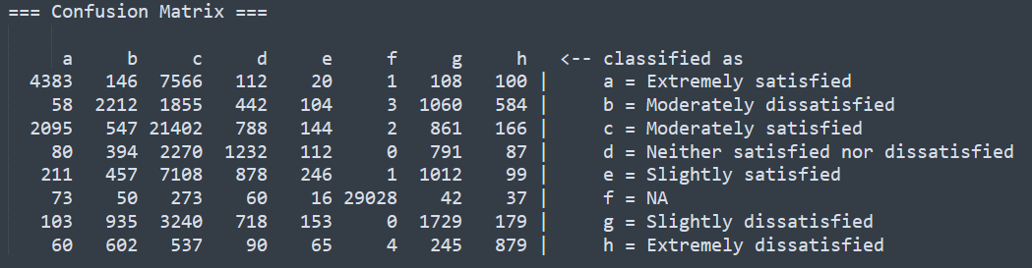
Results (Job Satisfaction) Simplified
Communication Tool.NA
Career Satisfaction
Career Satisfaction
Employment
Employment
Employment
Employment
…
…
Confidence Factor: 1/2^15
Accuracy: 62%

Slide 11
Job Satisfaction
As mentioned in the abstract it’s the stuff that isn’t in the tree that’s interesting
Age
Open source
How long coding (professionally/non-professionally)
What time you wake up
Hours spent on the computer in a day
Exercise
How many meals do you skip in a week

Slide 12
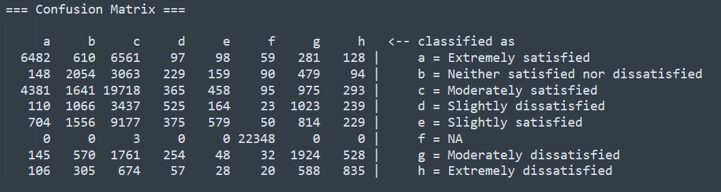
Results (Career satisfaction) Simplified
Communication Tool.NA
No
Yes
Job Satisfaction
Hope 5 Years
Job Satisfaction
Job Satisfaction
…
Confidence Factor: 1^-7
Accuracy: 55%

Slide 13
Career Satisfaction
Once again, it’s the stuff that didn’t show up that’s the most interesting
Age
Language shows up this time but only in circumstances where the number of examples is small (usually < 300).
Open source
How long coding (professionally/non-professionally)
Wake time
Hours on the computer
Exercise
How many meals do you skip in a week

Slide 14
Ethics Choice variables
EthicsChoice: Imagine that you were asked to write code for a purpose or product that you consider extremely unethical. Do you write the code anyway?
EthicsReport: Do you report or otherwise call out the unethical code in question?
EthicalImplications: Do you believe that you have an obligation to consider the ethical implications of the code that you write?

Slide 15
Results (Ethics choice) Simplified
EthicalImplications
Yes
No
No
Unsure/IDK
EthicsReport
No
Depends on what it is
Yes and publicly
Yes
Depends on what it is
No
Yes but only within the company
Depends on what it is
Depends on what it is
Confidence Factor: 1/2^14
Accuracy: 74%

Slide 16
Future Research
Look at the times where people are satisfied with their career and not satisfied with their job and vice versa and see if there is something that causes a person to be happy with their career but not their job.
Build a tree without career satisfaction for the job satisfaction tree and seeing how much accuracy changes. Likewise, do so for the career satisfaction tree.
Do a full study and ask participants what they think causes their job/career satisfaction.

